Slide 1




Front End Engineering-I Project
Team Details:
TARUN KUMAR
TEJAS GUPTA
TUSHAR
Faculty Coordinator : Mrs.Gaganpreet
Chitkara University Institute of Engineering and Technology,
Chitkara University, Punjab

Slide 2



Table of Contents
Introduction
Problem Statement
Technical Details
Key Features
Project Highlights
Conclusion
References/Links used

Slide 3


Introduction
Title- Tribute Page
The purpose of this project is to create a Memorable Tribute page for multiple individuals allows us to celebrate the diverse achievements and contributions of those who have left a lasting impact. This page serves as a collective homage, weaving together narratives that showcase the unique stories, talents, and legacies of each person honored. Through shared memories and reflections, it becomes a digital tapestry, preserving the essence of these remarkable individuals for others to appreciate and draw inspiration from..

Slide 4



Problem Statement
The webpage revolves around paying tribute to Multiple individual and effectively conveying there life story, achievements, and inspirational impact to visitors. To Create a web page that provides an overview of there life, including there early life, achievements, contributions, and inspirational journey.
Include sections that highlight key aspects of there life, such as his early life, achievements, contribution,inspiration, philanthropic activities, legacy and conclusion.Incorporate engaging and informative content that narrates there life story and emphasizes impact on the society

Slide 5


Technical Details
1)HTML (Hypertext Markup Language): HTML is used for structuring the content of the web page.
2)CSS (Cascading Style Sheets): CSS is used for styling the web page, including fonts, colors, layout, and positioning.
3)Text Editor or Integrated Development Environment (IDE): You can use a text editor like Visual Studio Code or an IDE like WebStorm for writing and editing HTML and CSS code.
4)Java: The JavaScript code defines a function showHiddenPass for toggling the visibility of a password input.
It takes two parameters: the ID of the password input and the ID of the eye icon.
The function uses event listeners to switch between password and text visibility and update the eye icon accordingly.

Slide 6


Key Features
1.Responsive Design:
The page layout is designed to be responsive with a maximum width of 800px for the content, ensuring a pleasing user experience on various screen sizes.
2.Header Navigation:
The header contains a navigation section with a prominent title ("TRIBUTE PAGE") and navigation buttons ("Logout," "About," "Contact Us") styled as inline-block buttons.
3 .Show/Hide Password Functionality:
A JavaScript function (showHiddenPass) is defined to toggle the visibility of the password input.
It uses the Remix Icon classes to change the eye icon when showing or hiding the password.

Slide 7
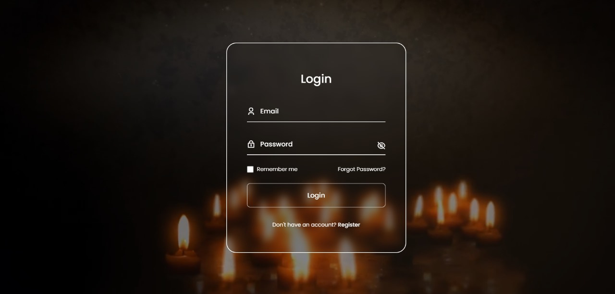

Project Highlights

Slide 8
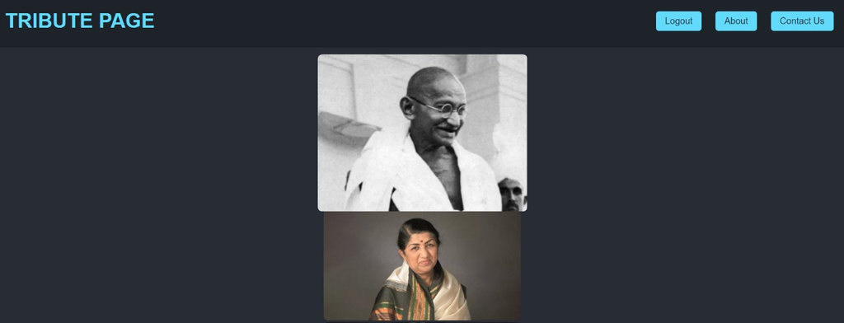


Project Highlights

Slide 9
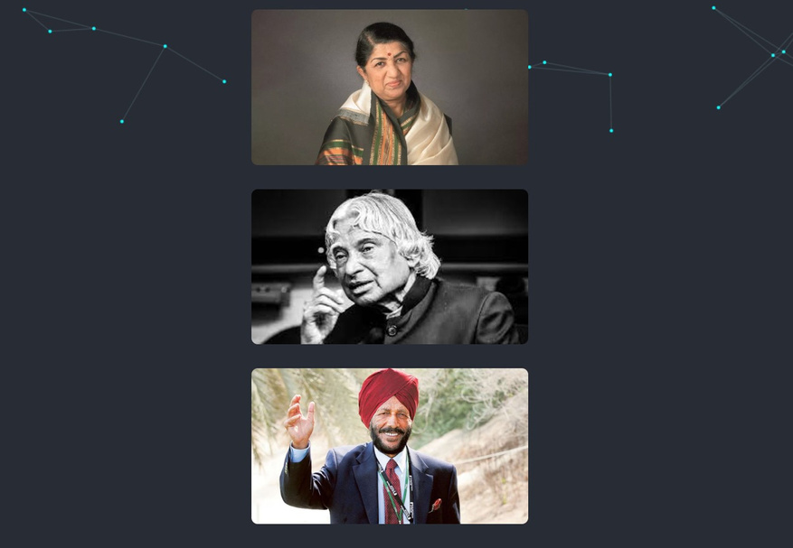

Project Highlights

Slide 10
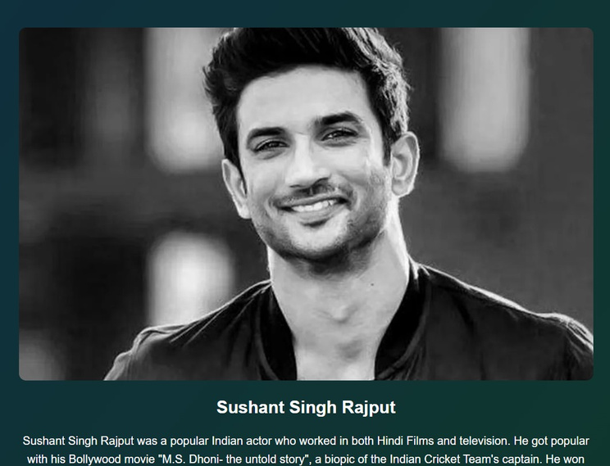
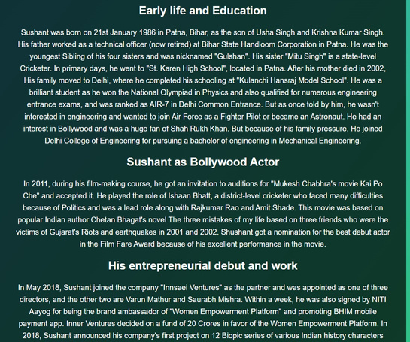


Slide 11
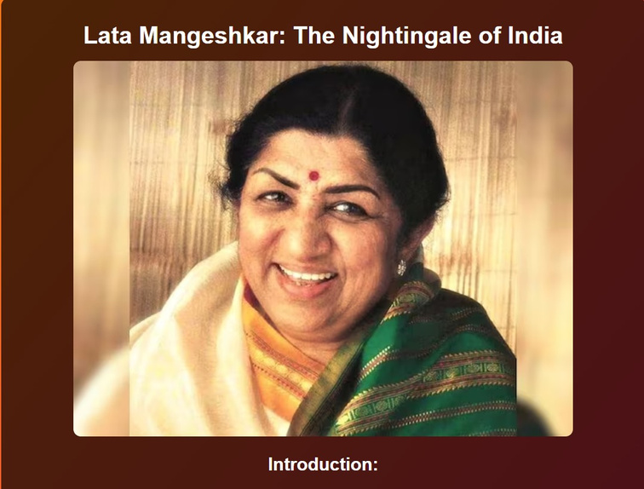
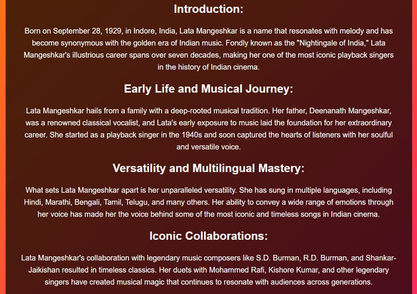


Slide 12
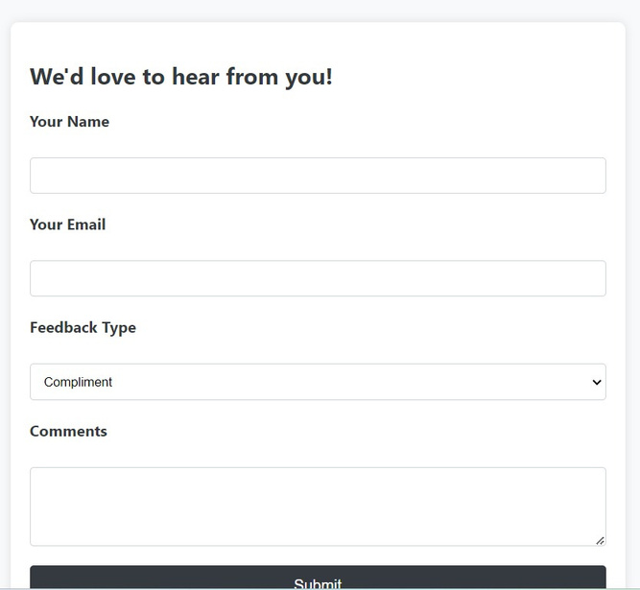


Slide 13
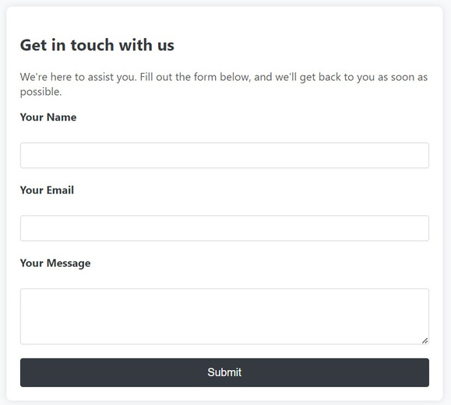



Slide 14

Conclusion
"In remembering of indian legend a symbols of determination, and an inspiration to us all. there remarkable journey will continue to inspire generations. Thank you for visiting and paying tribute to this remarkable souls. For more information or to share your own thoughts and memories, please feel free to contact us tejasgupta079@gmail.com
With deepest respects,Feel free to adapt and expand upon this conclusion to best fit the purpose and tone of your tribute web page.

Slide 15

References/Links used
https://en.wikipedia.org/wiki/Milkha_Singh
https://en.wikipedia.org/wiki/Lata_Mangeshkar
https://en.wikipedia.org/wiki/Bhagat_Singh
https://en.wikipedia.org/wiki/Sushant_Singh_Rajput
https://en.wikipedia.org/wiki/Mahatma_Gandhi
https://en.wikipedia.org/wiki/A._P._J._Abdul_Kalam
https://en.wikipedia.org/wiki/Kalpana_Chawla

Slide 16


